Slide 1

MOTOR VEHICLE THEFTS
Stolen vehicle details from the New Zealand police department
AHMAD AMMAR

Slide 2
1
PROJECT OVERVIEW
Stolen vehicle data from the New Zealand police department's vehicle of interest database containing 6 months of data. Each record represents a single stolen vehicle, with data on vehicle type, make, year, color, date stolen and region stolen.
AHMAD AMMAR

Slide 3
2
TABLES
locations
make_details
stolen_vehicles
AHMAD AMMAR

Slide 4
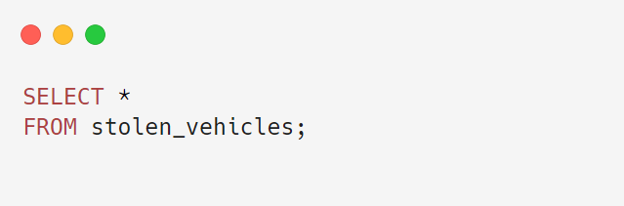
3
RETRIEVE ALL STOLEN VEHICLES:
AHMAD AMMAR

Slide 5
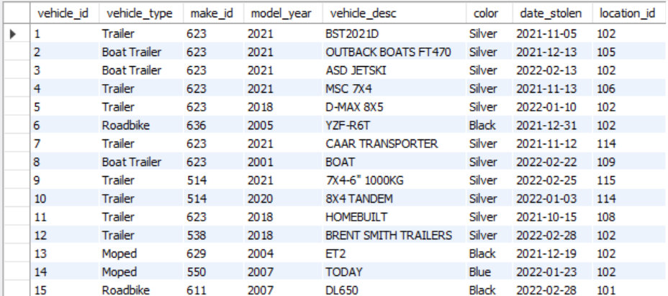
4
OUTPUT
AHMAD AMMAR

Slide 6
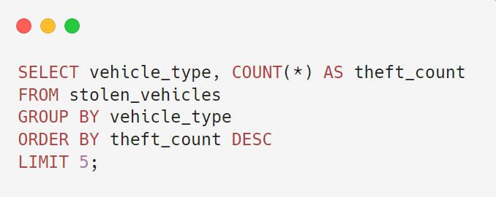
5
COUNT STOLEN VEHICLES BY VEHICLE TYPE
AHMAD AMMAR

Slide 7
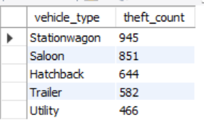
6
OUTPUT
AHMAD AMMAR

Slide 8
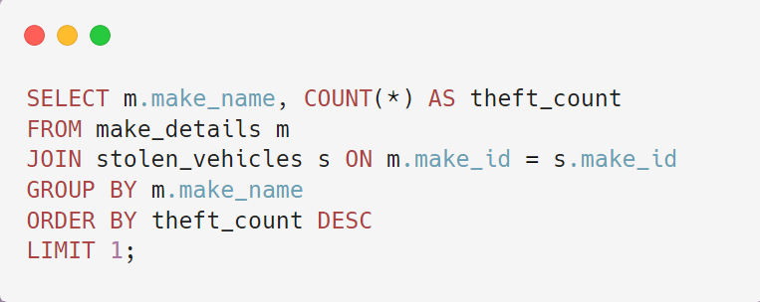
7
FIND THE MOST STOLEN VEHICLE MAKE:
AHMAD AMMAR

Slide 9
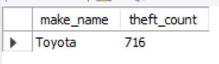
8
OUTPUT
AHMAD AMMAR

Slide 10
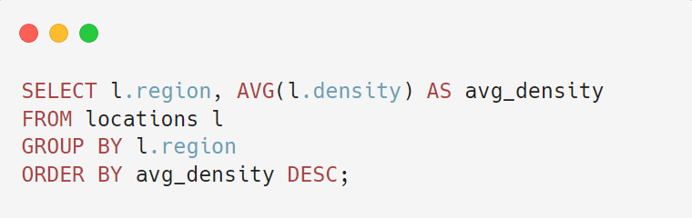
9
RETRIEVE THE 5 MOST RECENTLY STOLEN VEHICLES
AHMAD AMMAR

Slide 11
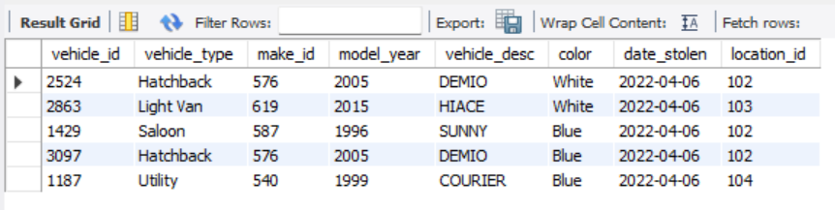
10
OUTPUT
AHMAD AMMAR

Slide 12
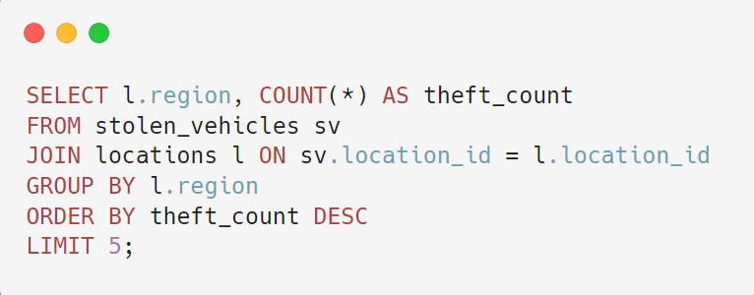
11
FIND THE TOP 5 REGIONS WITH THE HIGHEST NUMBER OF VEHICLE THEFTS
AHMAD AMMAR

Slide 13
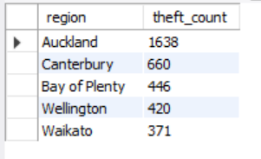
12
OUTPUT
AHMAD AMMAR

Slide 14
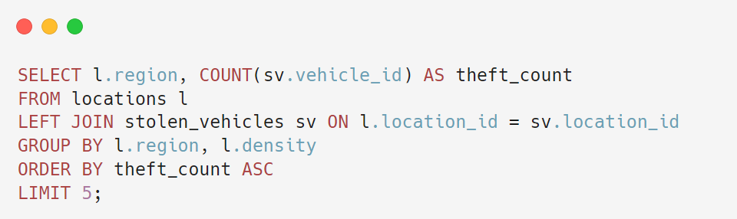
13
FIND THE TOP 5 REGIONS WITH THE LOWEST NUMBER OF VEHICLE THEFTS
AHMAD AMMAR

Slide 15
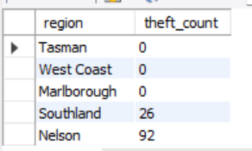
14
OUTPUT
AHMAD AMMAR

Slide 16
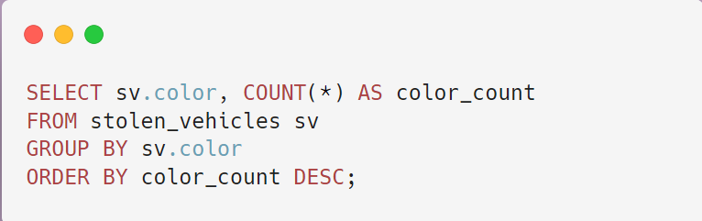
15
IDENTIFY COMMON COLORS OF STOLEN VEHICLES
AHMAD AMMAR

Slide 17
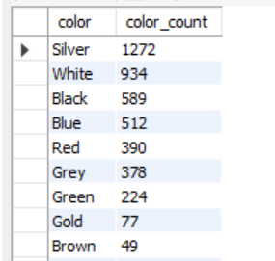
16
OUTPUT
AHMAD AMMAR

Slide 18
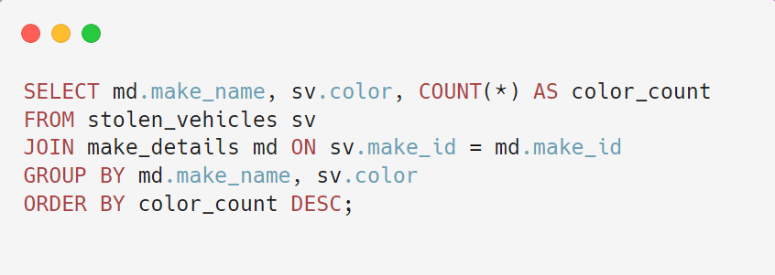
17
IDENTIFY COMMON COLORS OF STOLEN VEHICLES BY MAKE
AHMAD AMMAR

Slide 19
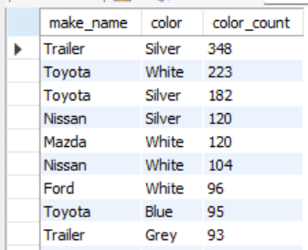
18
OUTPUT
AHMAD AMMAR

Slide 20
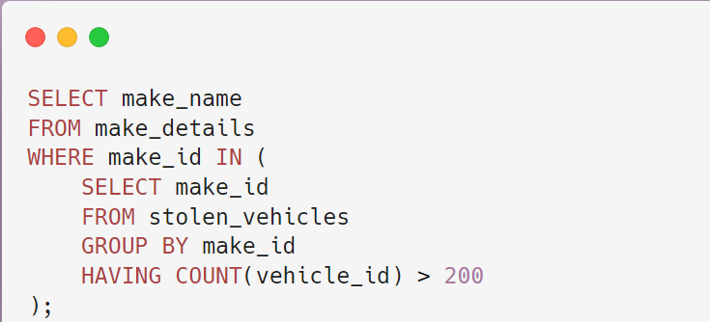
19
FIND VEHICLE MAKES WITH MORE THAN 200 THEFTS
AHMAD AMMAR

Slide 21
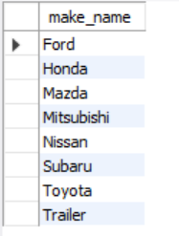
20
OUTPUT
AHMAD AMMAR

Slide 22
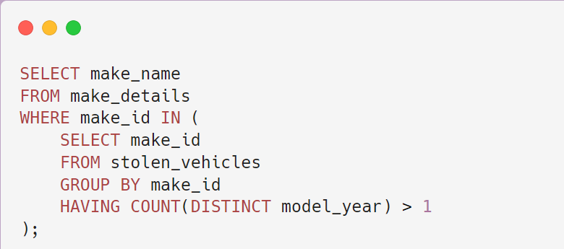
21
FIND VEHICLE MAKES WITH MODELS STOLEN IN MULTIPLE YEARS
AHMAD AMMAR

Slide 23
22
OUTPUT
AHMAD AMMAR

Slide 24
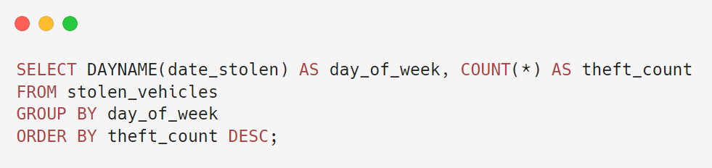
23
FIND THE DAY OF THE WEEK WITH THE MOST VEHICLE THEFTS.
AHMAD AMMAR

Slide 25
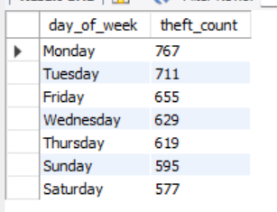
24
OUTPUT
AHMAD AMMAR

Slide 26
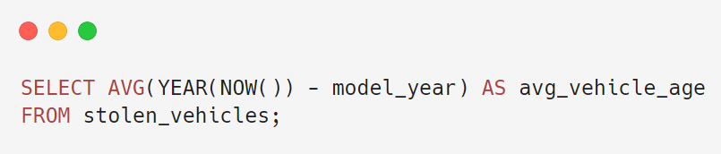
25
WHAT IS THE AVERAGE AGE OF THE VEHICLES THAT ARE STOLEN?
AHMAD AMMAR

Slide 27
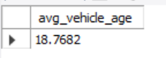
26
OUTPUT
AHMAD AMMAR

Slide 28
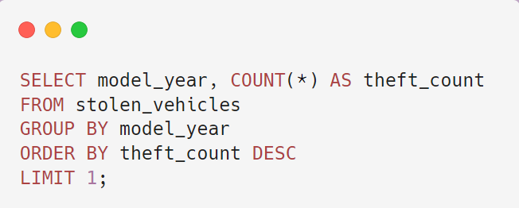
27
IDENTIFY THE MOST COMMON MODEL YEAR FOR STOLEN VEHICLES
AHMAD AMMAR

Slide 29
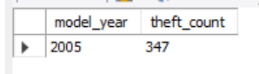
28
OUTPUT
AHMAD AMMAR

Slide 30
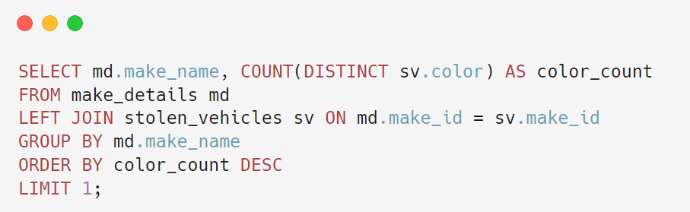
29
IDENTIFY THE MOST COMMON MODEL YEAR FOR STOLEN VEHICLES
AHMAD AMMAR

Slide 31
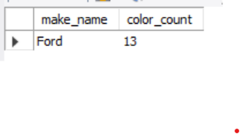
30
OUTPUT
AHMAD AMMAR

Slide 32
THANK YOU
AHMAD AMMAR

